Slide 1

Deacon:
Greet one another with a holy kiss.*Lord have mercy. Lord have mercy. Lord have mercy. Yea, Lord, who are Jesus Christ, the Son of God, hear us and have mercy upon us. Offer, offer, offer in order. Stand with trembling. Look towards the east. Let us attend.
*Romans 16:16
Greet One Another
liturgy of the faithful

Slide 2
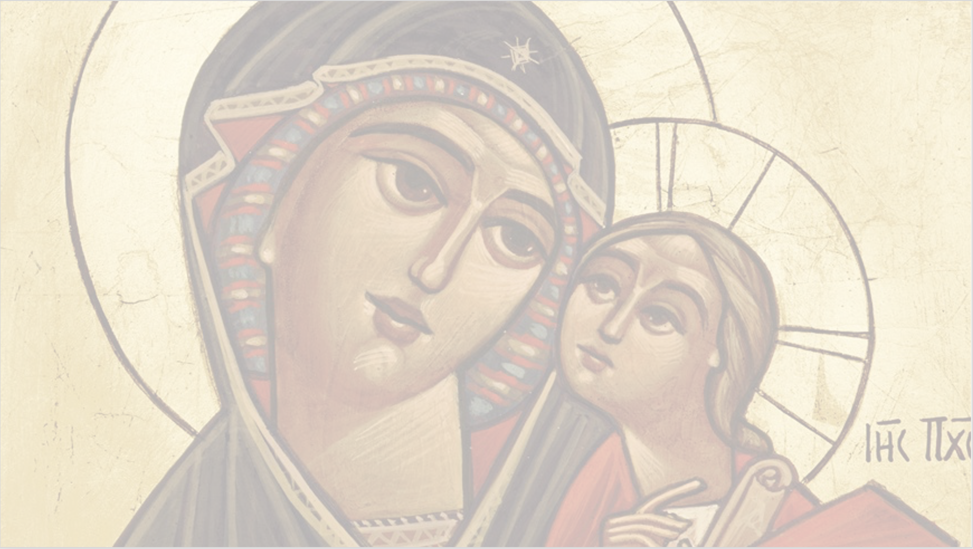
Through the intercessions,
of the Theotokos Saint Mary,
O Lord, grant us the forgiveness of our sins.

Slide 3
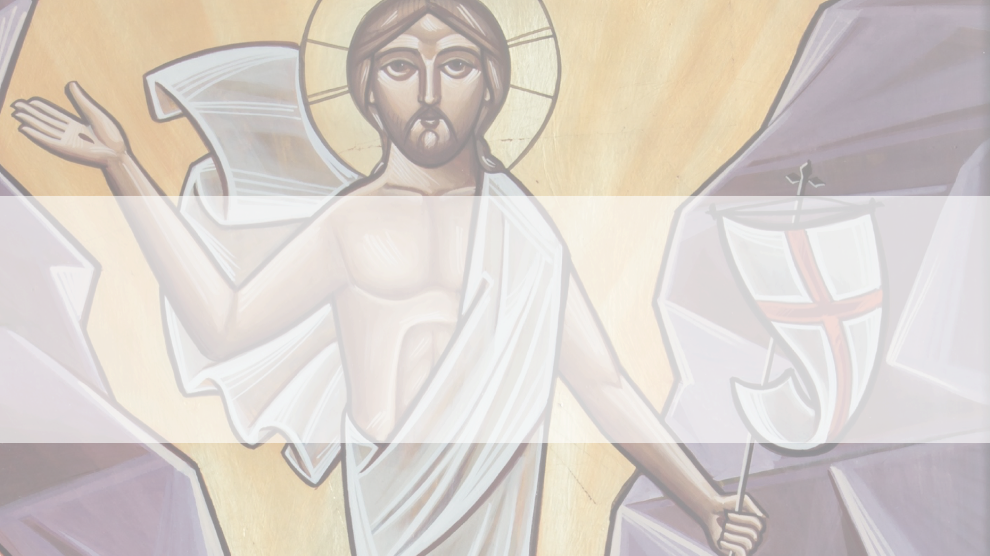
We worship You O Christ,
with Your good Father, and the Holy Spirit,
for You #SEASON# and saved us.
A mercy of peace, a sacrifice of praise.

Slide 4
Priest:
The Lord be with you all.
People:
And with your spirit.
Priest:
Lift up your hearts.
People:
We have them with the Lord.
Anaphora
liturgy of the faithful

Slide 5
Priest:
Let us give thanks to the Lord.
People:
It is meet and right*.
Priest:
Meet and right, meet and right; truly, indeed, it is meet and right.
*Worthy and Just
Anaphora
liturgy of the faithful

Slide 6
O You, THE BEING, Master, Lord, God of truth, being before the ages and reigning forever; who dwells in the highest and looks upon the lowly*; who has created the heaven, the earth, the sea, and all that is therein;
*Psalm 138:6
Anaphora
liturgy of the faithful

Slide 7
the Father of our Lord, God, and Savior Jesus Christ, by whom You have created all things, visible and invisible*; who is seated upon the throne of His glory; and who is worshipped by all the holy powers.
Deacon:
You who are seated, stand.
Anaphora
liturgy of the faithful

Slide 8
Priest:
Before whom stand the angels, the archangels, the principalities, the authorities, the thrones, the dominions, and the powers.
Deacon:
Look towards the East.
Anaphora
liturgy of the faithful

Slide 9
Priest:
You are He around whom stand the Cherubim full of eyes, and the Seraphim with six wings, praising continuously, without ceasing, saying:*
Deacon:
Let us attend.
*Isaiah 6:2
Anaphora
liturgy of the faithful

